Slide 1
Amazon product review analysis
Xin Pang
9/12/2017

Slide 2
Why understanding product reviews is important?
Problem statement
According to research, 88% of consumers trust online reviews as much as a personal recommendation buying a product.
In a similar study 85% of consumers say they read up to 10 reviews before purchasing.
This means…
Not understanding customer review behavior, is akin to not providing more than 85% of the customers the information they want to help them make their buying decisions.
In-depth understanding of customer reviews will result in new marketing opportunities.
Purpose of the analysis
To understand customer rating and review behavior
To understand what type of reviews are helpful reviews
To understand what are the satisfied / dissatisfied aspects from based on customer review text
Consumer benefits
Optimized review display for faster information seeking in buying process
In-time issue-resolving after purchase
As a result…
Overall improved shopping experience
Business benefits
Customer service: identify improvment areas through critical reviews
Product research: easy restructuring of merchandising and product selection
Marketing: targeted marketing campaigns based on customer feedback
As a result…
Overall higher customer loyalty and engagement through optimized shopping experience

Slide 3
Customer rating: overview
Avg. rating
4.66
4.62
4.56
4.36
4.31
4.30
4.30
4.28
4.24
4.23
4.21
4.21
4.18
4.18
4.17
4.14
4.14
4.13
4.09
4.08
4.07
4.05
4.05
3.85
Observations
Over 1 month period 1.49M users generated 2.95M reviews, on average one user wrote 1.98 reviews. Among all the product categories, the average rating is 4.21 stars out of 5 stars.
People tend to either give 4 or 5-star ratings (>50% of population) or 1-star ratings.
Cell phones & accessories received the lowest rating. 14.2% users in the cell phones & accessories category gave a 1-star rating.
Recommendations
Customer dissatisfaction is the main reason of churn. Besides, due to the word-of-mouth effect, it is crucial to understand dissatisfaction reasons to avoid negative brand image.
Further root-cause analysis for product & service team to identify dissatisfaction in cell phones & accessories products.
Notes:
Data range: one month data in March 201
Total users: 1,495,199
Total reviews: 2,952,306

Slide 4

Customer rating: what makes a good rating?
Take CD business as an example, the composition of an above 4.5-star rating, we need…
5%
5%
15%
75%
For the phone & accessories business to improve by 0.5 star, per 100 people we need…
10 less
3 less
3 more
12 more

Slide 5
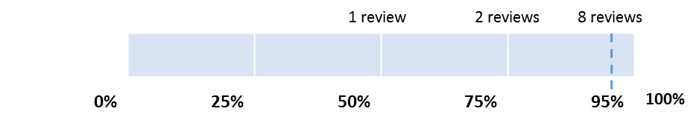
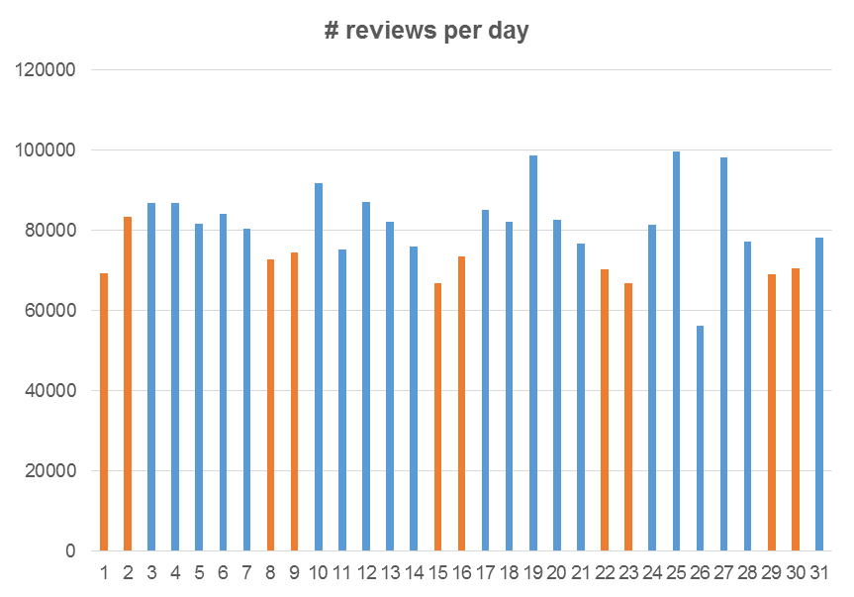
Customer review text: overview
# reviews received per product
Observations
Number of reviews per product
On average each product receives 2.70 reviews. 95% of the products received no more than 8 reviews.
Product reviews exhibit a long-tail effect, i.e. only a few products receive an extremely large amount of reviews, whereas the majority of products receive only one or two reviews.
Customers are likely to write long reviews for high priced (>=100$) product. The length of reviews is slightly positively correlated (correlation = 0.14, significance level = 0.01) with the price. No correlation is observed between number of reviews and price.
Recommendations
Customers are cautious when buying expensive products, therefore it is crucial that plenty of reviews with sufficient information exist for expensive products.
For customers who bought expensive product, they need to be encouraged to write more reviews by sending notifications / reward points / coupons.

Slide 6
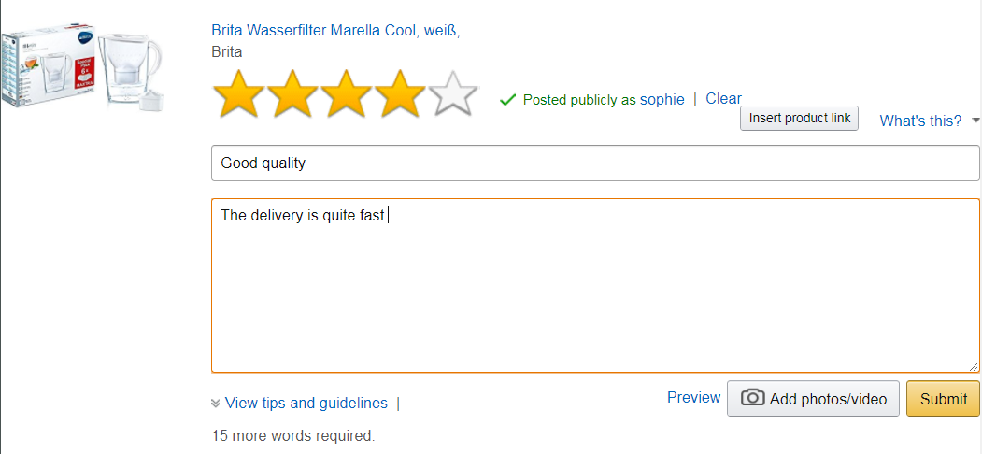
Customer review text: overview
Text length
I purchased a book but I received a book which was a black and white scan copy of the original book. I’m very disappointed.
25%
Observations
Length of reviews
Half of the customer population write review with no more than 29 words, which is about 2 sentences.
More than three quarters of the customers write <= 65 words, which is about 5 sentences.
Recommendations
Even though we should encourage customers to write more than 2 sentences, writing a review should be motivating and fun, and should not be a burden for customers.
Suggestion is to change the tone for the description in the review text box, instead of “X more words required”, we can encourage users by saying “Good work! Just write one more sentence and you will be helping 10 other people making their decisions when buying this product!”, or showing a progress bar interactively changing when the user types.
Purchased a book on Amazon.com. But I received a book which was a black and white scan copy of the original book with lots of missing pages. So bad.
50%
I purchased a book on Amazon.com. But I received a book which was a black and white scan copy of the original book with a lot of missing pages. I asked for a replacement and again I received the same type of book. When I tried to give my feedback on my experience in the website it was not accepting the same. I’m very disappointed.
75%
Notes:
24, 29, 65

Slide 7
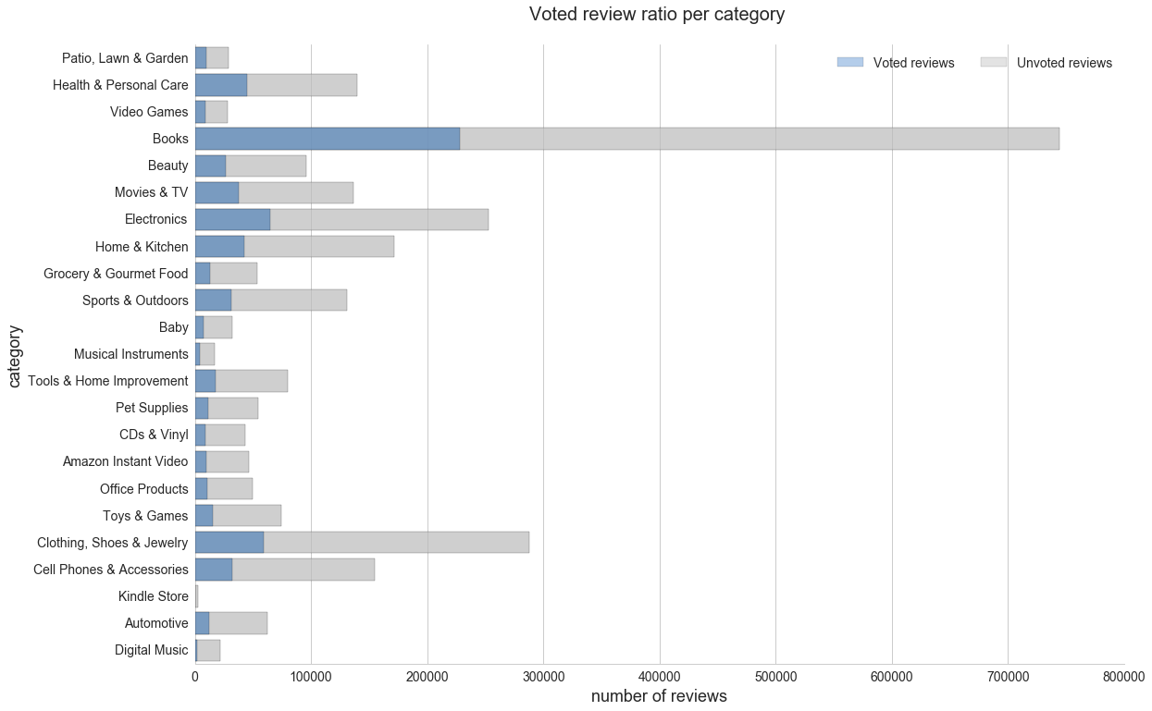
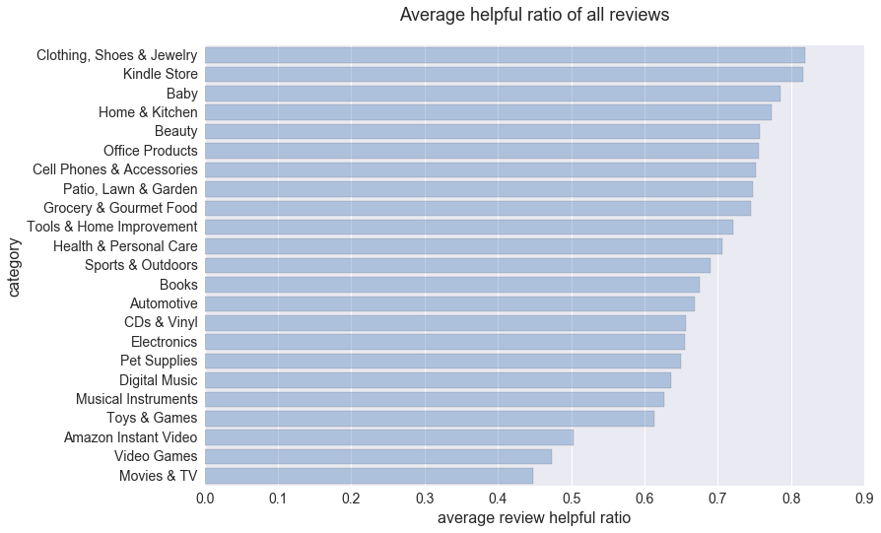
Customer review: how helpful are the reviews?
Books received the most number of helpful reviews due to the large amount of purchasing.
Voted review ratio per category (descending)
Avg. helpful ratio of all reviews (descending)

Slide 8
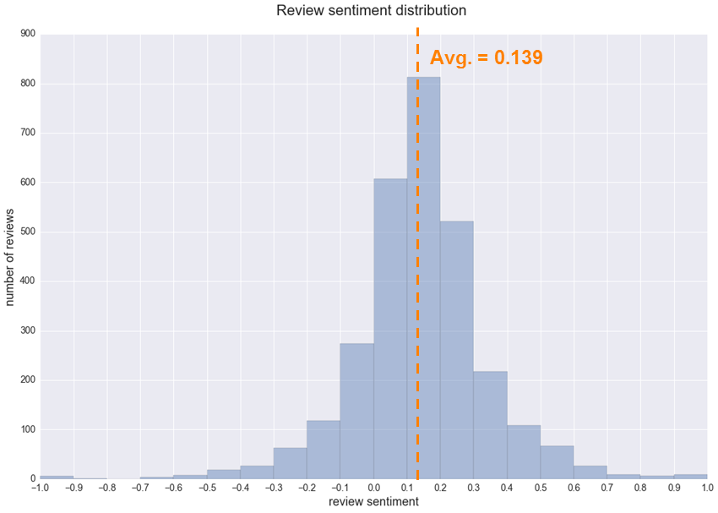
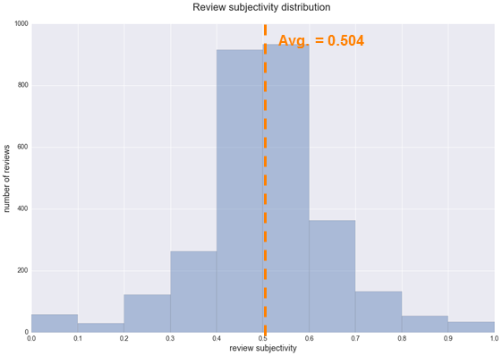
Customer review: sentiment analysis (electronics)
Observations
While
Notes:
Total review: 2900

Slide 9
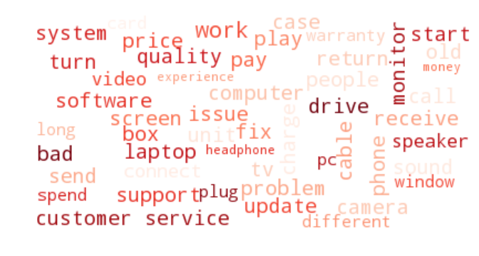
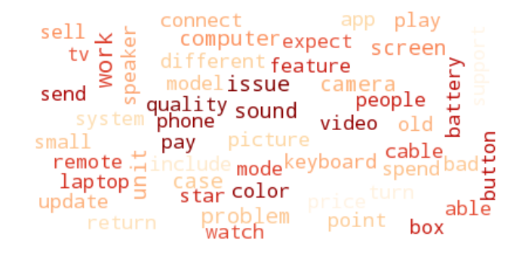
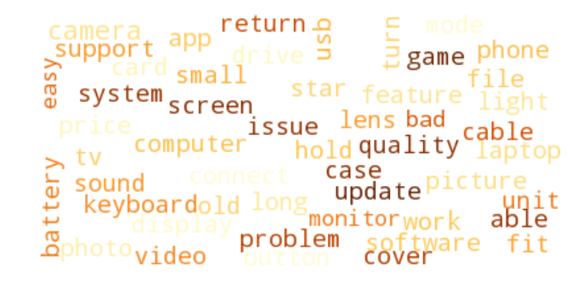
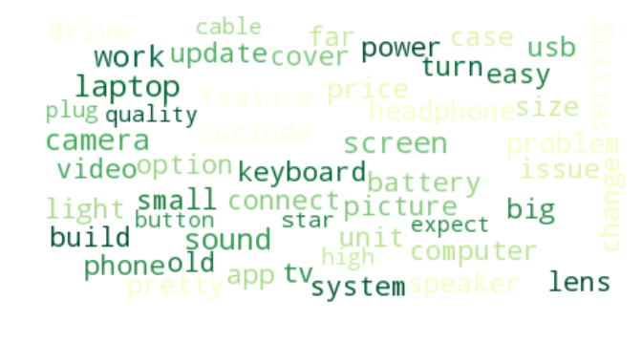
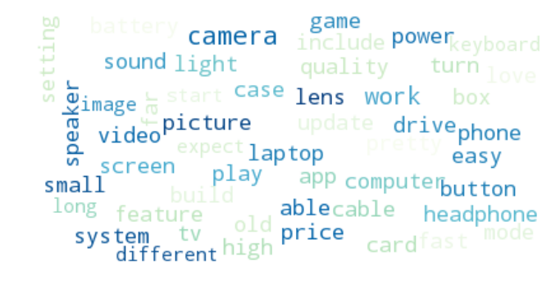
Customer review: what do customers say (electronics)?
1-star
2-star
3-star
4-star
5-star

Slide 10
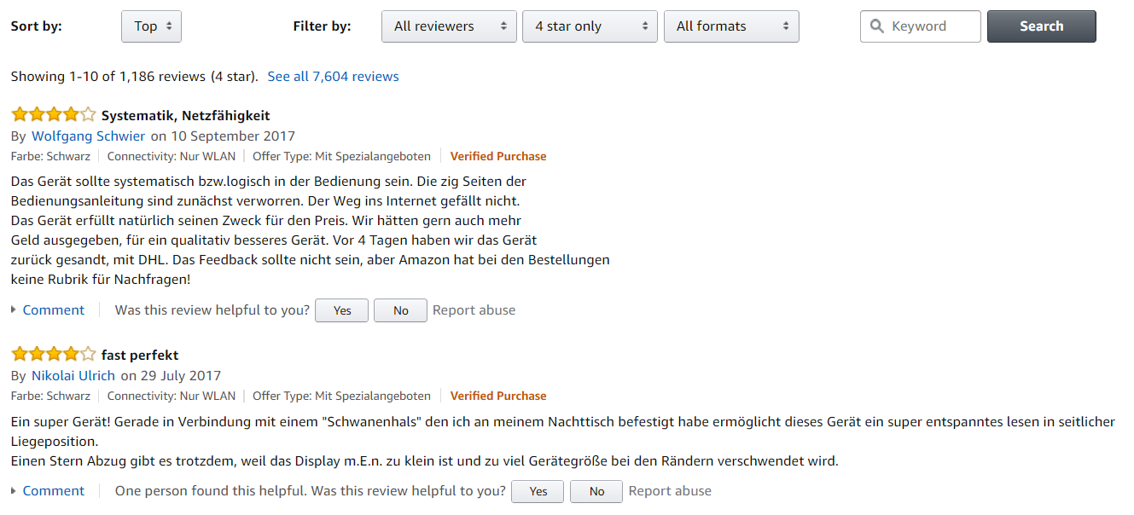
Customer review: sentiment analysis (electronics)
Observations
5-star ratings are not always full of satisfaction. While customers are giving 5 stars, they also put critical points in the review text.
Low rating customers mainly have issues on the following aspects of an electronic product:
Product quality
Price (quality-price ratio)
Warranty
Usage issues
Returning product
Customer service
While high rating customers also focus on similar aspects, they tend to express with more positive characteristics of the product, e.g. easy, fast, light, pretty.
Recommendations
While Amazon offers the flexibility of filtering reviews based on the star rating, it is not always easy for customers to find the experience information they are looking for.
By adding a summary of the common concerns of customers, e.g. quality, price, warranty, and filter text based on these aspects, it will be easier for them to find the relevant information.

Slide 11
Summary
User experience
Organize reviews: simplify the process to find the reviews that matter most to consumers by organizing reviews and ratings into specific groups.
Optimize search experience: for products based on customer feedback.
Review text design: re-phrasing the words to
Product selection optimization
Make sure adequate inventory of highly reviewed products.
Remove poorly reviewed products with most negative reviews and complaints.
Marketing
Provide top 10 lists of the products that received the best reviews accessible from the product category pages.
Launch marketing campaign based on the top reviewed and rated products.

Slide 12
Design choice
Database considerations
Dataset size (~ 60GB after extraction)
Data structure (json)
Speed
Scalability
Technical choices
MongoDB to store all the data
Python for data processing and natural language processing

Slide 13
Data fields
Product review data
Metadata
reviewerID - ID of the reviewer, e.g. A2SUAM1J3GNN3B
asin - ID of the product, e.g. 0000013714
reviewerName - name of the reviewer
helpful - helpfulness rating of the review, e.g. 2/3
reviewText - text of the review
overall - rating of the product
summary - summary of the review
unixReviewTime - time of the review (unix time)
reviewTime - time of the review (raw)
asin - ID of the product, e.g. 0000031852
title - name of the product
price - price in US dollars (at time of crawl)
imUrl - url of the product image
related - related products
also bought
also viewed
bought together
buy after viewing
salesRank - sales rank information
brand - brand name
categories - list of categories the product belongs to

Slide 14
List of questions
Questions | Dataset
Is there a relation between reviews from products which are bought together? | Review + meta
What is the relation between the reviews and the helpfulness? | Review
What is the review behavior among different categories? | Review + meta
Is there a relation between price and reviews? | Review + meta
Optional - any other hypothesis you think is interesting, as long it would have business value for Amazon

